Slide 1

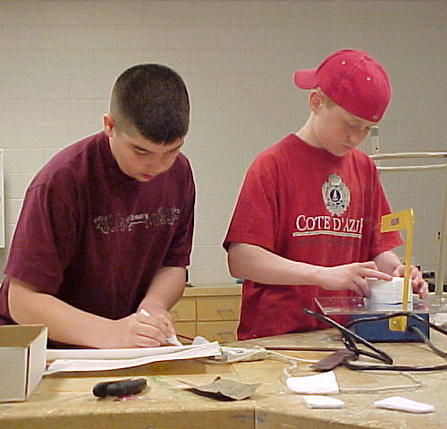
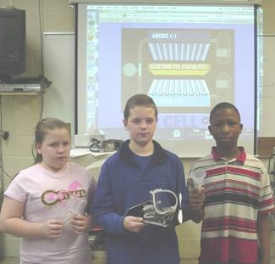
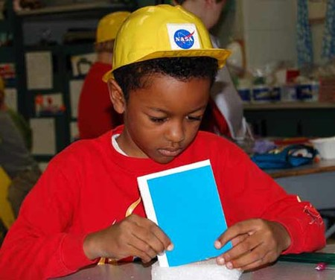
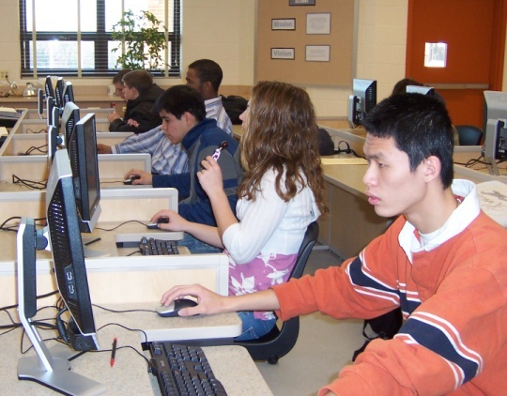


Foundations of Technology
Problem-Solving Activity
Teacher Resource – First Five Days: Day 1
© 2016 International Technology and Engineering Educators Association
STEM Center for Teaching and Learning™
Foundations of Technology
Notes:
© International Technology Education Assoc
Slide #<number>
TITLE SLIDE
12/01/2009
STEMCenter for Teaching & Learning™ Engineering byDesign™

Slide 2

The BIG Idea
Big Idea:
The 21st century skills of collaboration and problem solving are essential for engineering solutions of the future.
© 2016 International Technology and Engineering Educators Association
STEM Center for Teaching and Learning™
Foundations of Technology
Notes:
[Authors: Please include teacher notes appropriately.]
© International Technology Education Assoc
Slide #<number>
12/01/2009
STEMCenter for Teaching & Learning™ Engineering byDesign™

Slide 3
What is the Problem?
Design a self-propelled vehicle that will transport a passenger safely from point A to Point B.
Restrictions:
  You may only use the provided materials.
  You have one class period to complete
  the activity.
© 2016 International Technology and Engineering Educators Association
STEM Center for Teaching and Learning™
Foundations of Technology
Notes:
[Authors: Please include teacher notes appropriately.]
© International Technology Education Assoc
Slide #<number>
12/01/2009
STEMCenter for Teaching & Learning™ Engineering byDesign™

Slide 4
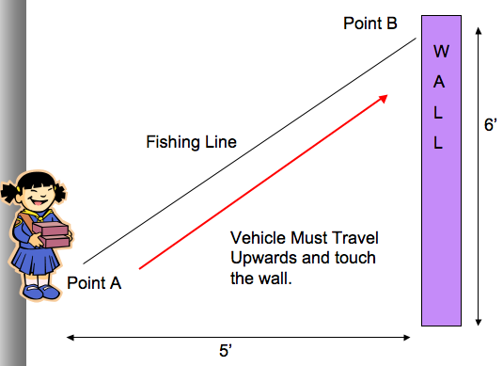
Course Layout
© 2016 International Technology and Engineering Educators Association
STEM Center for Teaching and Learning™
Foundations of Technology
Notes:
[Authors: Please include teacher notes appropriately.]
© International Technology Education Assoc
Slide #<number>
12/01/2009
STEMCenter for Teaching & Learning™ Engineering byDesign™

Slide 5




Materials
You must construct a vehicle to travel from point A to point B under its own power using only the following materials:
  12” of Masking tape
  1 Popsicle Stick
  1 Balloon
  2 paper clips
  2 rubber bands
  1 Clothespin for a passenger
© 2016 International Technology and Engineering Educators Association
STEM Center for Teaching and Learning™
Foundations of Technology
Notes:
[Authors: Please include teacher notes appropriately.]
© International Technology Education Assoc
Slide #<number>
12/01/2009
STEMCenter for Teaching & Learning™ Engineering byDesign™

Slide 6
What are your Guidelines?
You can only use the materials provided.
It must travel along a fishing line in an upward direction from point A to point B.
You cannot assist the vehicle in traveling up the string.
The passenger must arrive safely without falling off the vehicle.
The vehicle must remain in one piece.
The vehicle must remain on the string after reaching point B.
© 2016 International Technology and Engineering Educators Association
STEM Center for Teaching and Learning™
Foundations of Technology
Notes:
[Authors: Please include teacher notes appropriately.]
© International Technology Education Assoc
Slide #<number>
12/01/2009
STEMCenter for Teaching & Learning™ Engineering byDesign™

